Slide 1

YAXLEY AIS Vs GIS
July 2025

Slide 2
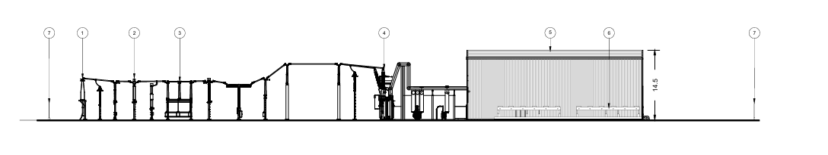
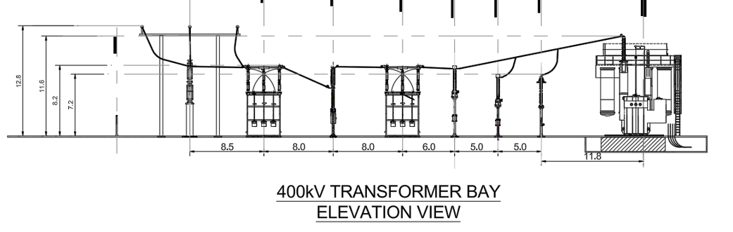
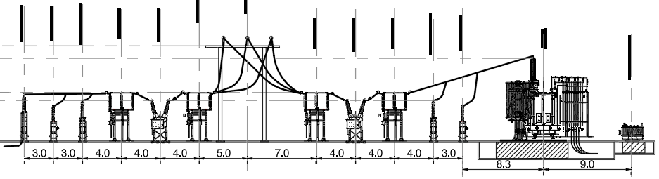
Elevations
400kV
132kV
Conrad
R8

Slide 3
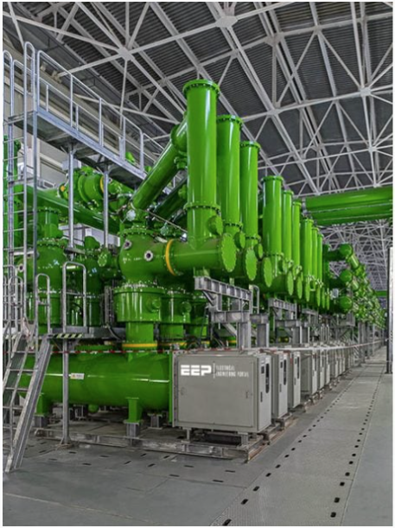


400kV GIS
National Grid Planning Statement Quote

Slide 4
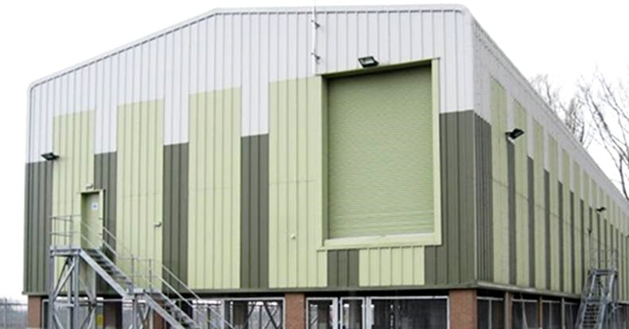
GIS Building

Slide 5
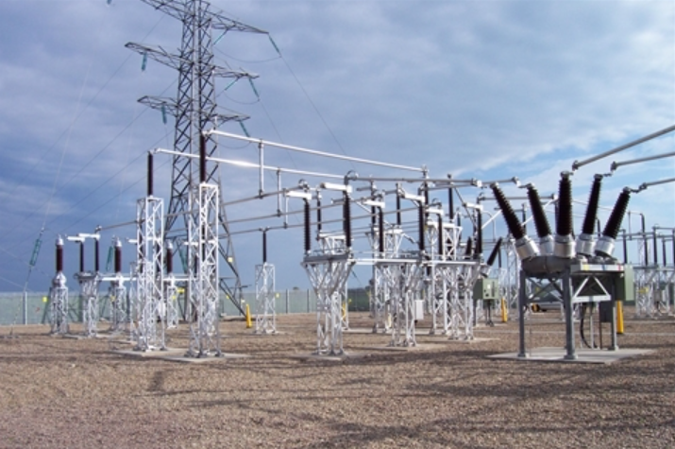
400kV AIS

Slide 6
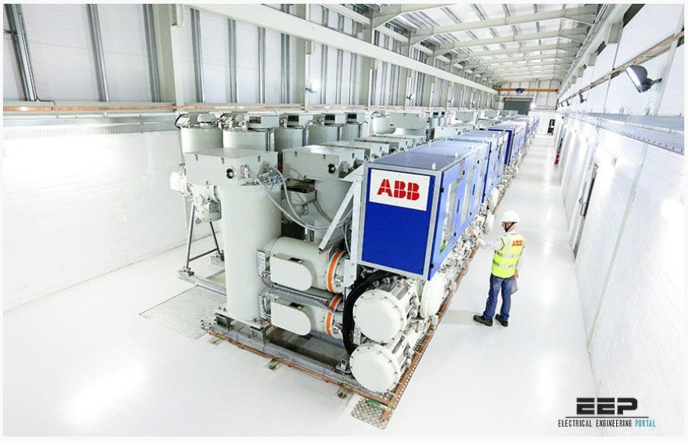
132kV GIS

Slide 7
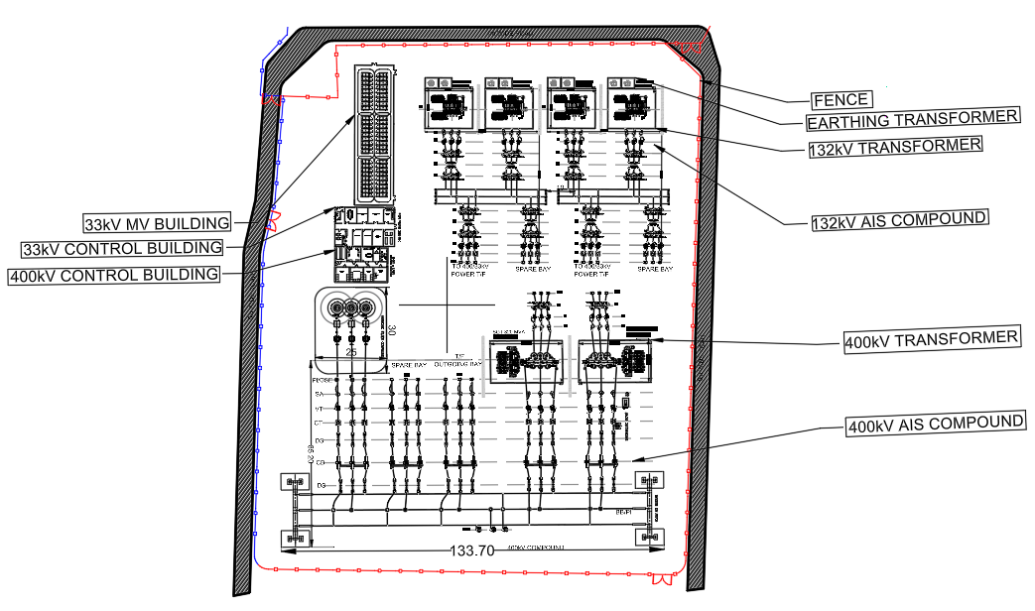
R8 Plan
We have (approximately) shaded red the elements which would be housed indoors if we designed the project as GIS opposed to AIS.
We would expect the area shaded red to be reduced by around 40% if this was a GIS solution. The building height could be as large as 15-16m high if GIS is opted for. We would usually only opt for GIS when space is tight.

